Slide 1
Confidence Intervals and Hypothesis Tests

Slide 2
What do you really need to learn?
The big idea: we make estimates, try to summarize our uncertainty about them.
The idea of a Confidence Interval presumes we can:
Imagine a sampling distribution
Find a way to, using only one sample, get estimate of how uncertain we are.
This can be tricky, but we will try to understand the important cases clearly (and defer the unusual ones).

Slide 3


Slide 4
Calculating Confidence Intervals
A CI requires us to know the sampling distribution of our estimator and then we grab the middle 95% (typically).
Generally a function of the standard error of the estimate, sample size
Not all CIs are symmetric, but the easiest ones to visualize are symmetric (sample means, regression coefficients).
Every Estimator has its own CI formula
The challenge of the CI is that there is no universal formula
For some estimates, we have “known solutions”.
Some estimators have no agreed-upon CI.

Slide 5
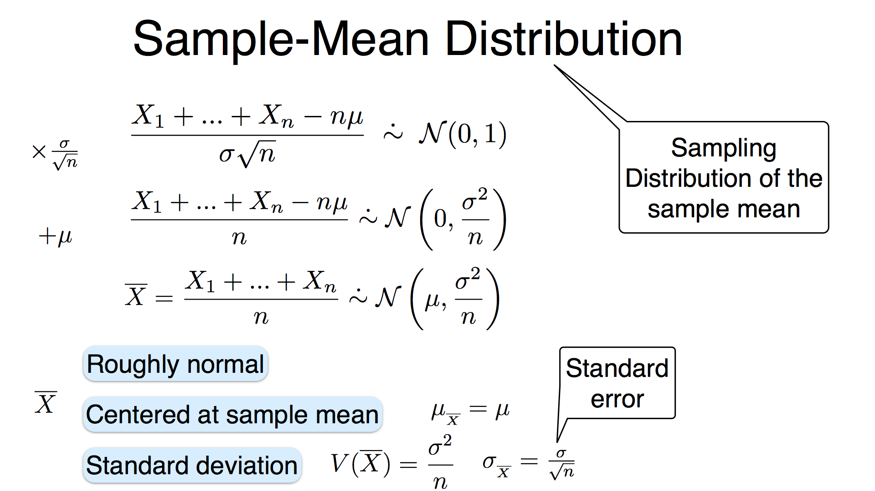
Sampling Distribution

Slide 6
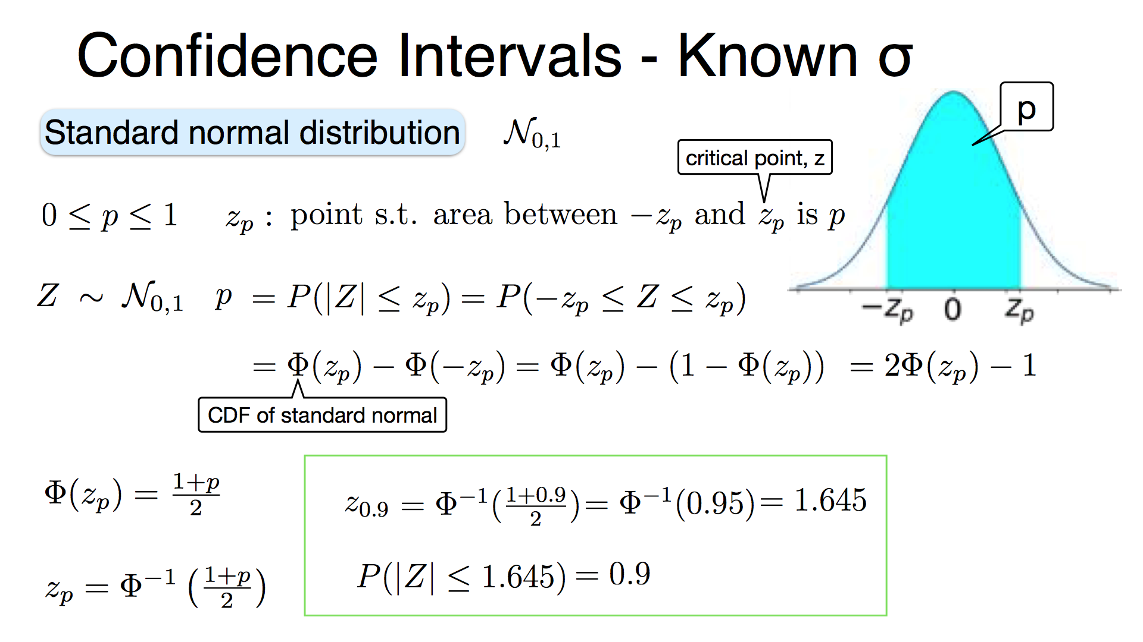

Slide 7
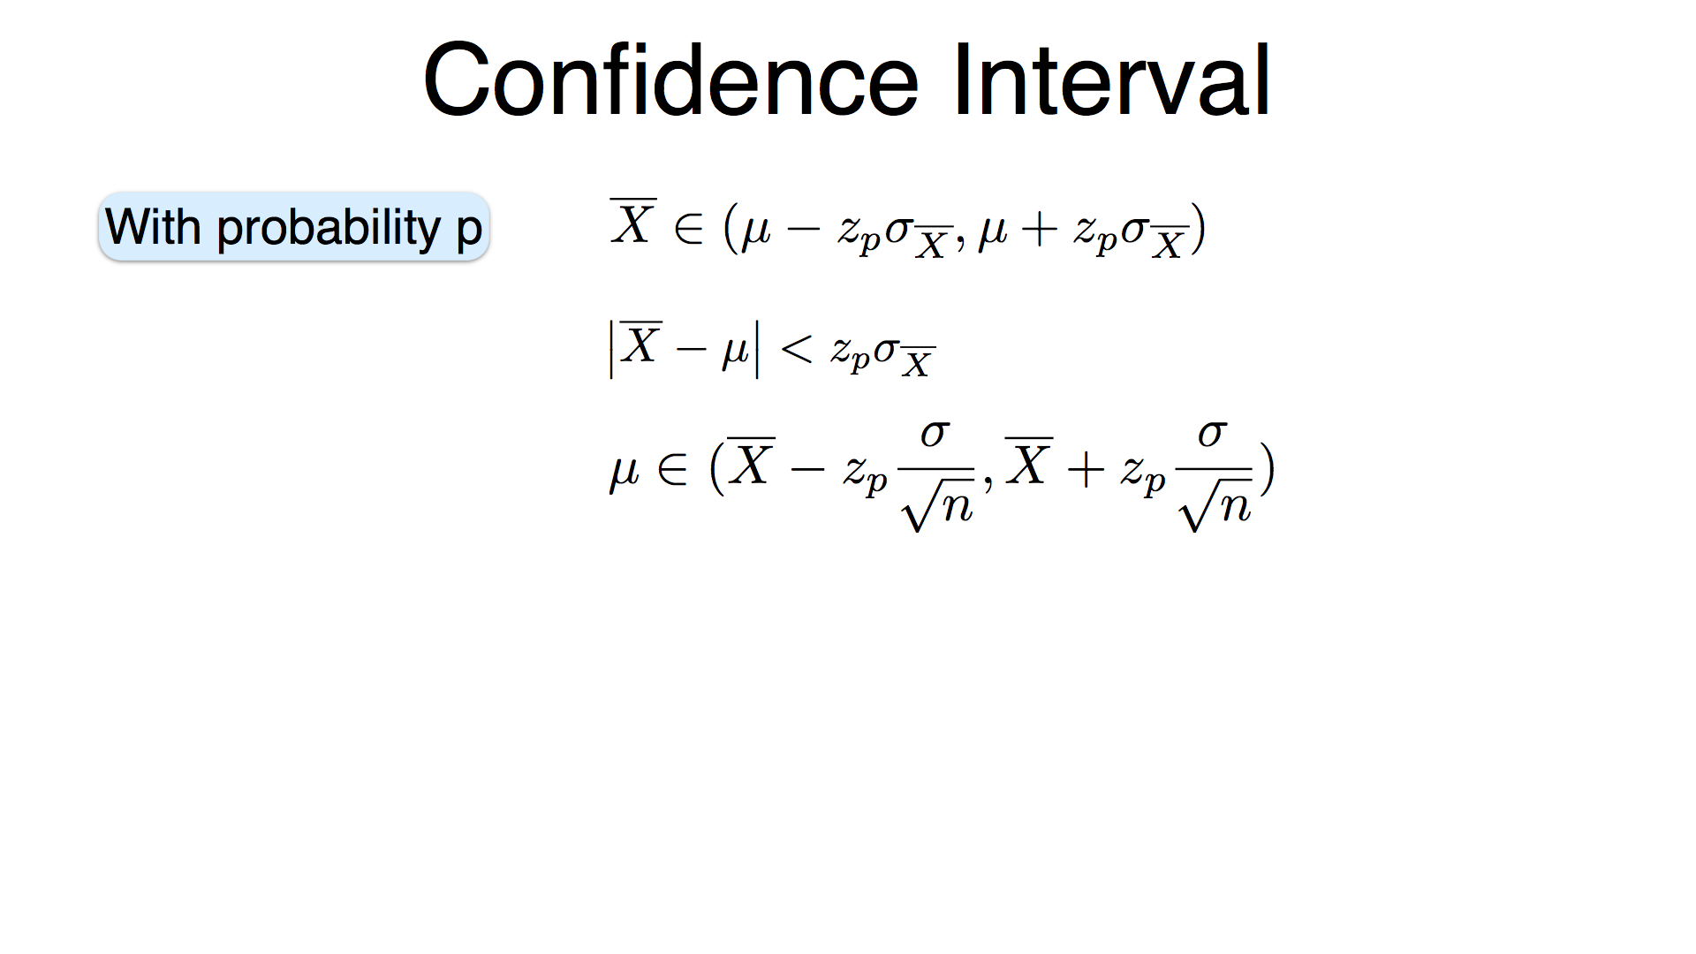
Sampling Distribution
A 95% Confidence Interval would have 2 meanings
Repeated Sampling: 95% of sample estimates would fall into CI
Degree of Belief: The probability is 0.95 that θ is in CI

Slide 8
1.96 is a Magic Number
Correct Answer:
We stipulated that the sampling distribution was Normal. The probability of an outcome below −1.96 is 0.025 and the chance of an outcome greater than 1.96 is 0.025.
Today:
scipy.stats.norm.ppf(x, loc=0, scale=1)
percent point function, quantile function

Slide 9
Confidence Intervals – Unknown σ
So far we’ve assumed that we know the variance of the underlying distribution.
What do we do if we don’t know the variance of the distribution we’re sampling from?
Estimate it!
Ok, but…

Slide 10
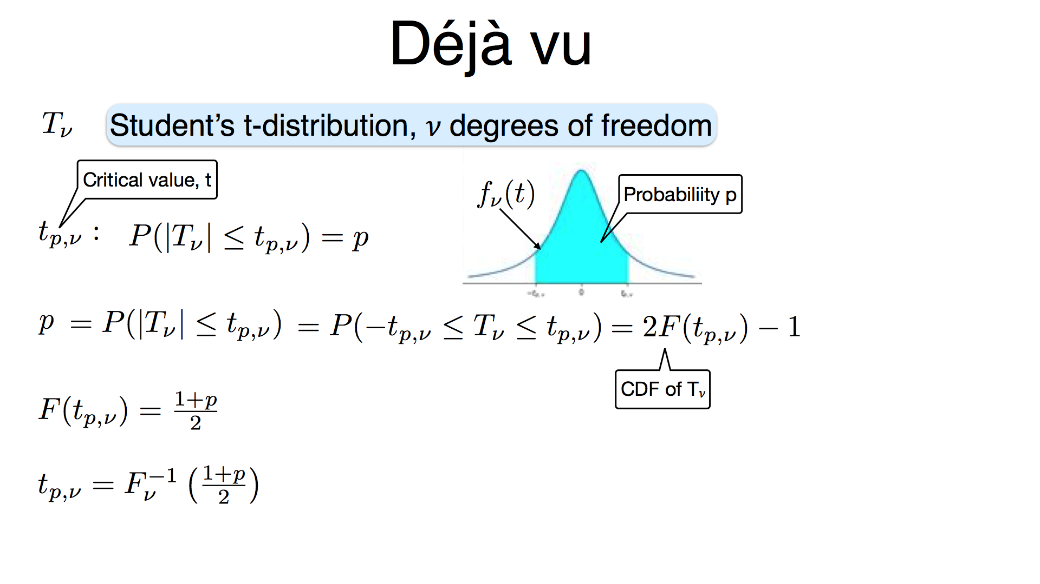

Slide 11
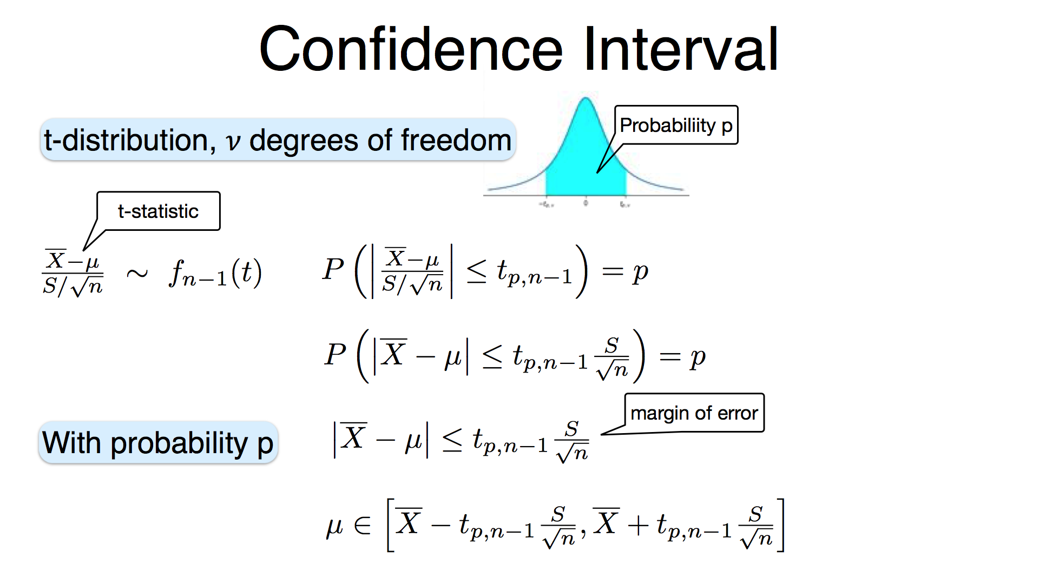

Slide 12
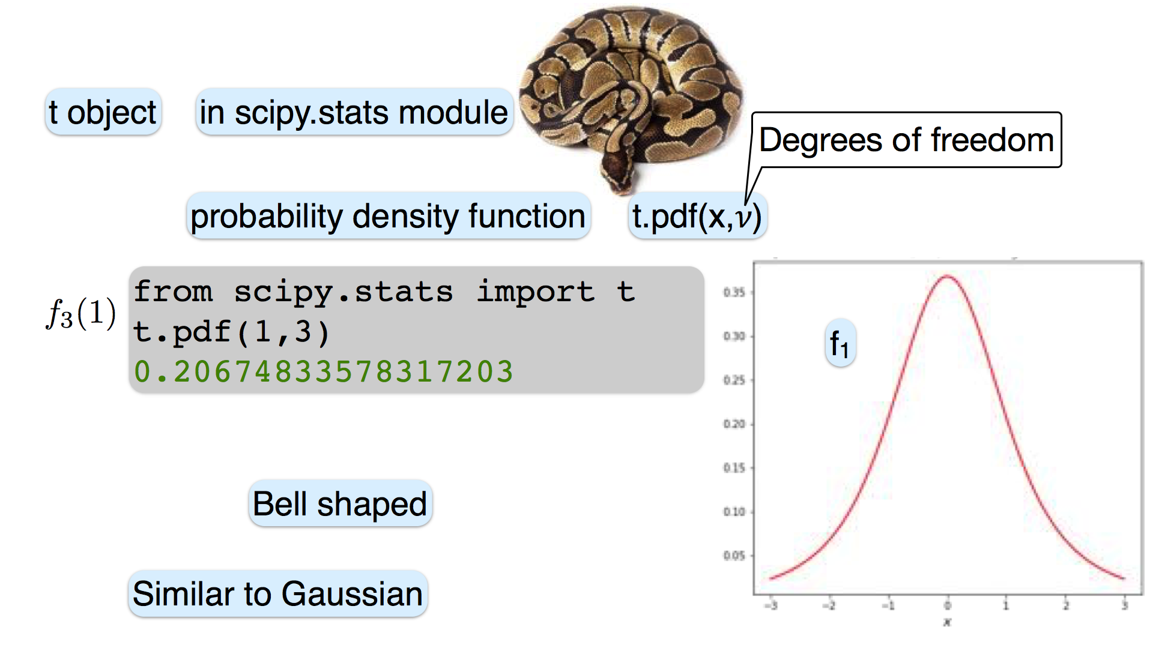

Slide 13
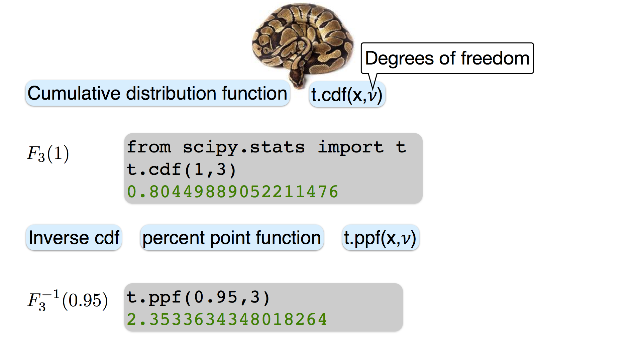

Slide 14
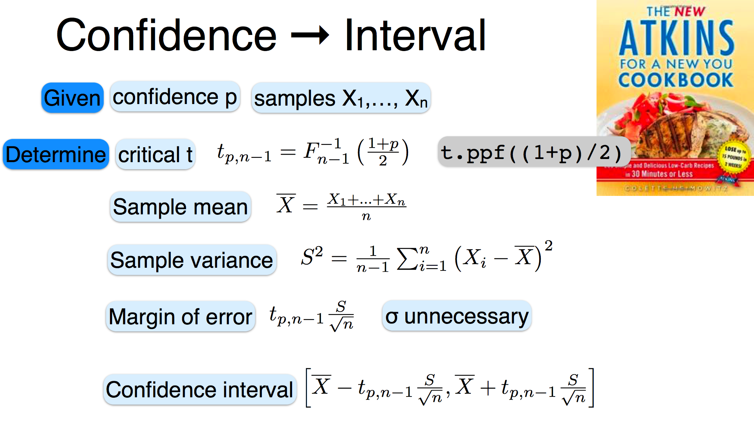

Slide 15
So what?
As long as you know the“sampling distribution”, you can figure out a confidence interval.
Work is easier if the CI is symmetric around the estimator.
For Asymmetric sampling distributions, CI have to be approximated numerically (difficult)

Slide 16
Hypothesis Testing Framework
One way of assessing if a statement is true is to presume that it is false and marshal evidence to the contrary.
Null hypothesis (H₀) vs Alternative Hypothesis (H₁ or H_{a})
Compute the likelihood of this value being explained by the assumptions of the Null Hypothesis.
If the evidence is sufficiently unlikely under the assumptions of the Null hypothesis we reject the null.
Note: We don’t accept the alternative, it just strengthens the case…
p-value := Probability of the statistic under the Null hypothesis

Slide 17
One/Two Sided Tests
α
In a one-tailed hypothesis test, we choose one direction for our alternative hypothesis:
we either hypothesize that the test statistic is “significantly big”, or that the test statistic is “significantly small”.
In a two-tailed hypothesis test, our alternative hypothesis encompasses both directions:
we hypothesize that the test statistic is simply different from the predicted value.

Slide 18
One Sided Tests Two Sided Tests
H₀: μ = 0 H_{a}: μ < 0
H₀: μ = 0 H_{a}: μ > 0
H₀: μ_{x} = μ_{y} H_{a}: μ_{x} > μ_{y}
H₀: μ = 0 H_{a}: μ ≠ 0
H₀: μ_{x} = μ_{y} H_{a}: μ_{x} ≠ μ_{y}

Slide 19
Type I/II Errors
A false positive or Type I error happens when the null hypothesis is true, but we reject it. The probability of a Type I error is α.
A false negative or Type II error happens when the null hypothesis is false, but we fail to reject it. The probability of a Type II error is β
The statistical Power of a test is the probability of rejecting the null hypothesis when it’s false (or equivalently, 1 − β).
Power is usually computed based on a particular assumed value for the quantity being tested: “if the value is actually ___, then the power of this test is___.” It also depends on the threshold determined by α.
You can minimize either α or β, not both.

Slide 20
https://i.stack.imgur.com/x1GQ1.png

Slide 21
Hypothesis Testing Recipe
Formulate a Null/Alternative Hypothesis.
Pick a significance level α (typically 0.05).
Compute the test statistic on your data.
Assess the probability p of this test statistic under the Null hypothesis.
If p < α, reject the Null. Otherwise, fail to reject the Null.
https://i.stack.imgur.com/x1GQ1.png

Slide 22
Hypothesis Testing Recipe
Generally…
When σ is known => z-test
When σ is unknown => t-test
scipy.stats.ttest_1samp
scipy.stats.ttest_ind, statsmodels.stats.weightstats.ttest_ind
Two-sample test
Matched pairs? Reduce to one sample case
Common variances? Pool variance
Unequal variances? Welch’s t-test (lower power)
https://i.stack.imgur.com/x1GQ1.png

Slide 23
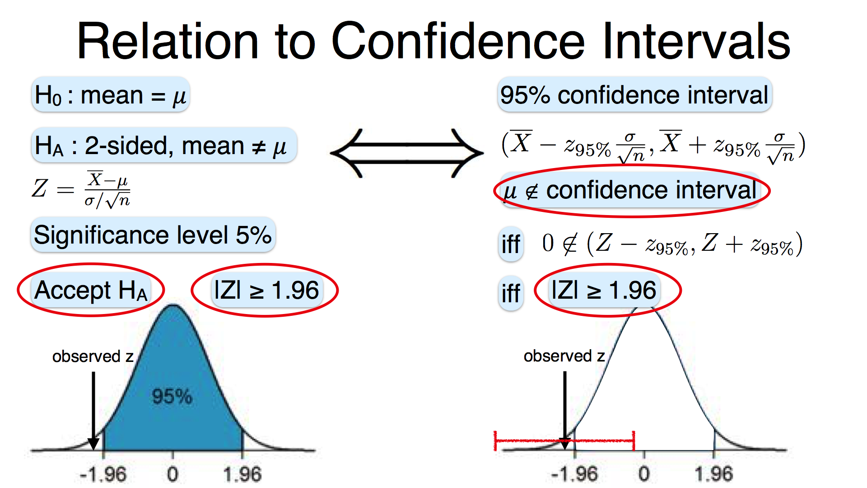
Notes:
You can never be completely sure that the null hypothesis is false from using a hypothesis test!
The first example below demonstrates this point.
There are ways of changing the methods to account for dependent samples…

Slide 24
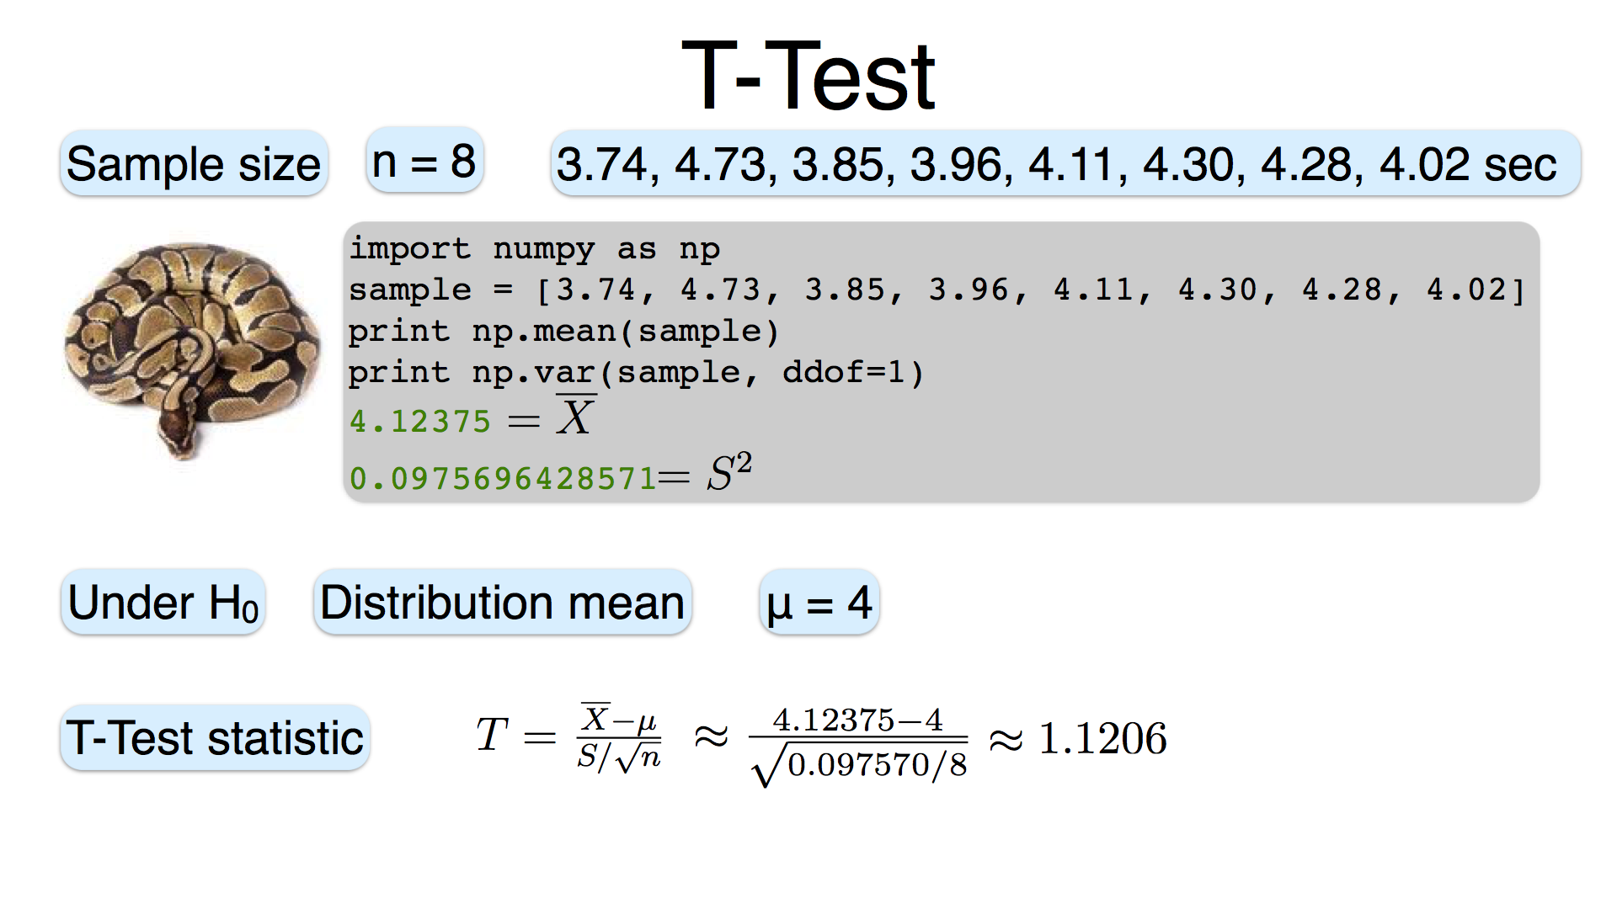
Notes:
You can never be completely sure that the null hypothesis is false from using a hypothesis test!
The first example below demonstrates this point.
There are ways of changing the methods to account for dependent samples…

Slide 25
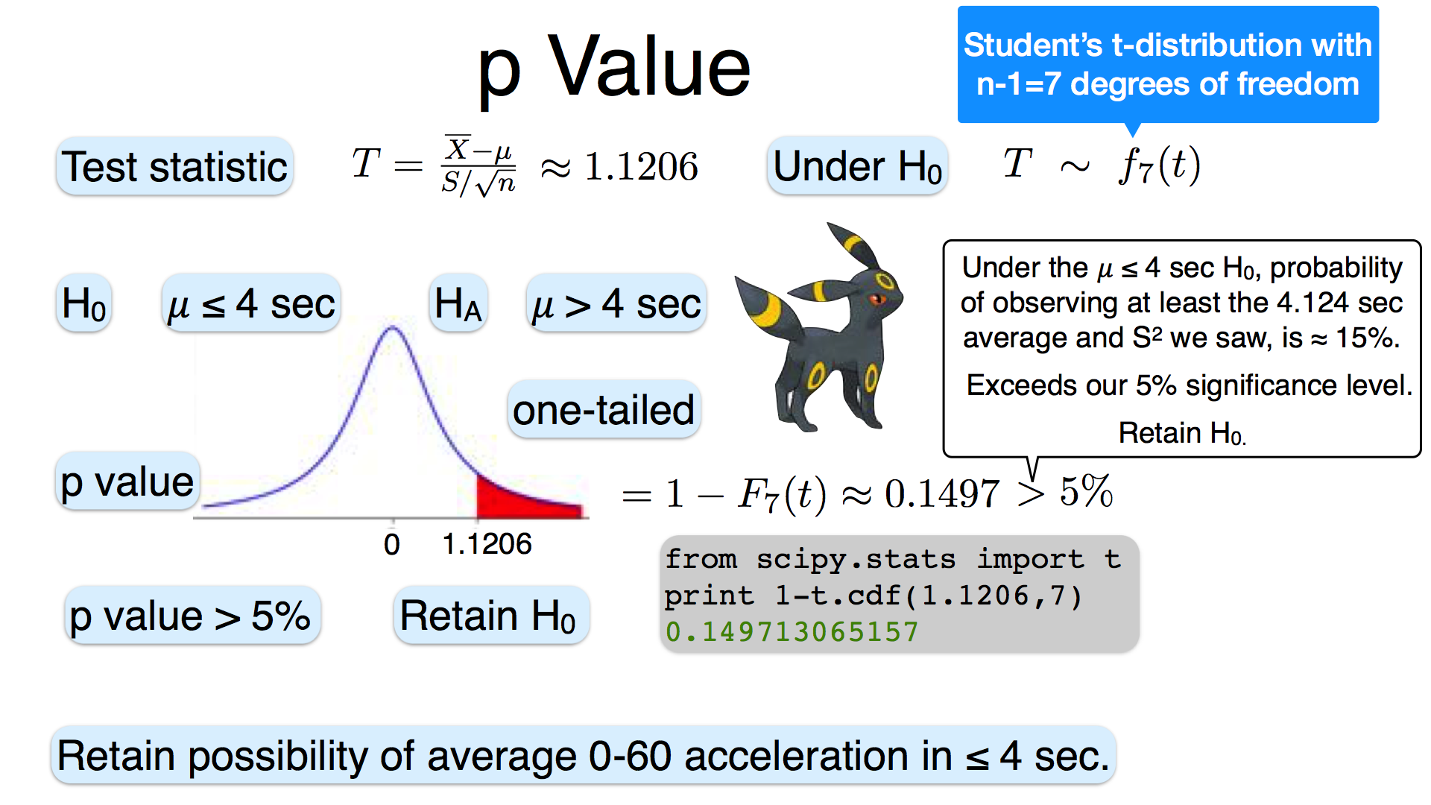
Notes:
You can never be completely sure that the null hypothesis is false from using a hypothesis test!
The first example below demonstrates this point.
There are ways of changing the methods to account for dependent samples…

Slide 26
Important Warnings for Hypothesis Testing !
Rejecting the null hypothesis: Any statement stronger than “the data do not support the null hypothesis” should be made with extreme caution.
Independent and identically distributed: Many of our derivations and methods depend on samples being independent and identically distributed. It’s important to be aware of the assumptions you need to use a particular method or test.
Practical vs statistical significance: with large enough n, any minutely small difference can be made statistically significant. Sometimes small differences like this matter (e.g., in close elections), but many times they don’t. Big Data is rife with this!
Notes:
You can never be completely sure that the null hypothesis is false from using a hypothesis test!
The first example below demonstrates this point.
There are ways of changing the methods to account for dependent samples…

Slide 27
XKCD 882

Slide 28
https://xkcd.com/882/

Slide 29
Correcting for Multiple Comparisons
Suppose you conduct 20 tests at a significance level of 0.05. Then on average, just by chance, even if the null hypothesis is wrong, one of the tests will show a significant difference!
There are a few standard ways of addressing this issue:
Bonferroni correction: If we’re doing m tests, use a significance value of α/m instead of α. Note that this is very conservative, and will dramatically reduce the number of acceptances.
False Discovery Rate (Benjamini-Hochberg): guarantees α overall error by using the very small significances to allow slightly larger ones through as well.

Slide 30
Practical vs Statistical Significance
Flip a coin 1,000,000 times, is it fair?
H₀: p = 0.5 H_{a}: p ≠ 0.5
We observe a sample proportion p-hat = 0.501, and check for significance
The large number of samples would lead to a p-value of 0.03. At a 5% significance level, we would declare this significant. For practical purposes, even if the true mean were in fact 0.501, the coin is almost as good as fair.
Notes:
The strong statistical significance we obtained does not correspond to a “practically” significant difference. Illustrate the null sampling distribution and the sampling distribution assuming a proportion of p = 0.501.

Slide 31
Practical vs Statistical Significance
Sampling distribution for p = 0.5 (black) and p = 0.501 (blue) for n = 1,000,000.
Notes:
Note the scale of the x-axis: the large number of samples dramatically reduces the variance of each distribution.

Slide 32
Solution
Gigantic samples
Large samples lead to more precise estimates of rho
(0.885 to 0.915)
AFAIK, there is no known formula for the exact sampling distribution of ρˆ or its CI. Formulae have been proposed to get better approximations of the CI
Fisher proposed a transformation that converts into a more normal distribution
Z = 0.5 Ln[ (1 + rho-hat)/(1 – rho-hat) ]
Create CI in transformed space, map back to get 95% interval, result is an asymmetric CI centered on the sample estimate.

